Slide 1
MODULE 3

Slide 2
Introduction to navigation design and signposts - Navigational models, Design conventions for websites, Patterns - clear entry points, menus, and breadcrumbs. Bootstrap 5's navigation components- navbar, dropdowns, and pagination.

Slide 3
NAVIGATION
In terms of User Interface (UI) design, Navigation is defined as the set of actions guiding the users navigate/move around the app so that they are able to complete their tasks easily.

Slide 4
NAVIGATION DESIGN
Navigation design involves creating, analyzing, and implementing ways for users to navigate through a website or app.
Effective navigation design is central to good user interface as it directly impacts user interaction and product use.
It helps users move from point A to point B (and beyond) with minimal frustration by employing UI patterns such as links, labels, and other elements to provide relevant information and facilitate easier interactions.

Slide 5
Why navigation design is so important
Easy-to-use navigation is key. Confusing menus and hard-to-find pages frustrate users and drive them away. That’s why good navigation is so important for a positive user experience. Here’s why:
Enhances understanding: Good navigation guides users effortlessly through your product, making it a easy to find what they’re looking for and achieve their goals.
Builds confidence: When paths are clear and menus are simple, users feel more comfortable and confident navigating the product.

Slide 6
Reflects your brand: A clear, easy-to-use design creates a great first impression, helping to build a strong brand identity.
Tells users their location: Think of navigation as a map that shows users where they are and how to get to other places. This reduces frustration and helps users feel more in control.
Supports accessibility: Inclusive navigation design is crucial. It ensures that everyone, including users with disabilities, can effectively use your product, broadening your audience and promoting inclusivity.

Slide 7
NAVIGATION -COST
Navigating an unfamiliar web page or application window incurs a cognitive cost (the amount of information needed )
Users quickly assess the layout, content, and navigation options, which requires mental effort and time.
Even familiar interfaces can impose this cognitive load, compounded by actual delays in loading or displaying content.
This cost impacts user experience, as prolonged loading times can frustrate users, leading them to abandon pages or avoid exploring the site altogether.
Effective design minimizes cognitive and loading costs to retain and engage users more effectively.

Slide 8
HOW TO NAVIGATE
Signposts
Signposts are features that help users figure out their immediate surroundings.
Common signposts include page and window titles, web page logos and other branding devices, tabs, and selection indicators.
Patterns and techniques such as good global and local navigation links, Sequence Map, Breadcrumbs, and Annotated Scrollbars etc tell users where they currently are, and often where they can go with only one more jump.
They help a user to stay “found” and to plan his next steps.

Slide 9
WAYFINDING
Wayfinding is what people do as they find their way toward their goal. These common-sense features help users with wayfinding:
Good signage
Clear, unambiguous labels anticipate what you’re looking for and tell you where to go; signs are where you expect them to be, and you’re never left standing at a decision point without guidance.
You can check this by walking through the artifact you’re designing and following the paths of all the major use cases.
Make sure that each point where a user must decide where to go next is signed or labeled appropriately.

Slide 10
Environmental clues
You would look for an “X” close button at the top right of a modal dialog and logos in the upper-left corner of a web page.
Keep in mind that these clues are often culturally determined, and someone new to the culture (e.g., someone who’s never used a given operating system before) will not be aware of them.
Maps
Sometimes people go from sign to sign or link to link without ever really knowing where they’re going in a larger frame of reference.
Also, in badly signed or densely built spaces, maps may be the only navigational aids people have.

Slide 11
TYPES OF NAVIGATION
3 TYPES
GLOBAL
UTILITY
INLINE OR ASSOCIATIVE
Global navigation is what’s found on every main screen.
It usually takes the form of menus, tabs, and/or sidebars, and this is how users move around the formal navigational structure of the site.

Slide 12
Utility navigation, also found on every main screen, contains links and tools related to non content aspects of the site or application: sign-in, help, print, Settings Editors language tools, and so on.
Associative and inline navigation embed links in or near the actual content. As the user reads or interacts with the site, these links present options that might be immediately relevant to the user. They tie content together thematically.

Slide 13
NAVIGATION MODELS
Navigation modeling is the process of designing and planning a navigation system for a website.
The navigation model helps determine how content will be organized and presented to users.
A navigation model is important because it helps you organize your website's content in a way that makes sense to your users.

Slide 14
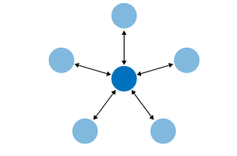
1. Hub and spoke
Most often found on mobile devices, this architecture lists all the major parts of the site or app on the home screen, or “hub.”
The user clicks or taps through to them, does what she needs to do, and comes back to the hub to go somewhere else.
This model uses a single central screen which acts to enable the user to explore different sections (spokes) of the app.
If you wish to shift from one spoke to another – you must do so via the hub. This is a good way of minimizing onscreen noise and works very well for apps that are more concerned with task execution than presenting large volumes of content.

Slide 15
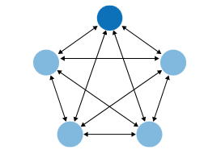
2. Fully connected
Many websites follow this model. There’s a home page or screen, but it and every other page link to all the others they each have a global navigation feature, such as a top menu.
The global navigation may be a single level , or it might be deep and complex, with multiple levels and deeply buried content.
As long as the user can reach any page from any other with a single jump, it’s fully connected

Slide 16
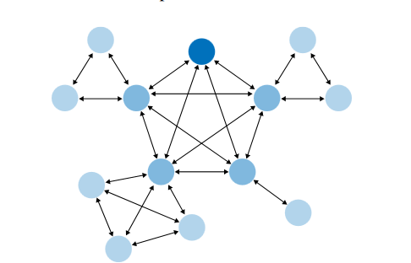
3. Multi-level
This is also common among websites .
The main pages are fully connected with each other, but the subpages are only connected among themselves (and usually to the other main pages, via global navigation).
You’ve seen this on sites that have subpages listed only in sidebars or subtabs users see these on menus that only show up after they’ve clicked the link for the main page or category.
It takes two or more jumps to get from one arbitrary subpage to another.

Slide 17

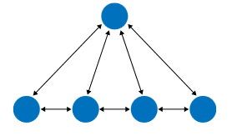
4. Stepwise
Slideshows, process flows, and Wizards lead the user step by step through the screens in a prescribed sequence
Back/Next links are prominent on the page.
5.Pyramid
A variant on the stepwise model, a pyramid uses a hub page or menu page to list an entire sequence of items or subpages in one
The user picks out any item, jumps to it, and then has the option to use Back/Next links to step through other items in order. He can go back to the hub page anytime.

Slide 18
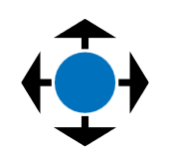
6. Pan-and-zoom
Some artifacts are best represented as single large spaces, not many small ones.
Maps, large images, large text documents, information graphics, and representations of time based media (such as sound and video) fall into this category.
Panning and zooming are still navigation so offer controls for panning (moving horizontally or vertically), zooming in and out, and resetting to a known position and state.

Slide 19
7.Flat navigation
Some types of applications need little or no navigation at all.
Consider Canvas Plus Palette applications such as Photoshop, or other complex apps such as Excel these offer tons of tools and functions that are easily reached via menus, toolbars, and palettes.
These types of applications seem to be qualitatively different from the other navigation styles listed here: the user always knows where he is, but he may not easily find the tools he needs because of the sheer number of features available at one time

Slide 20
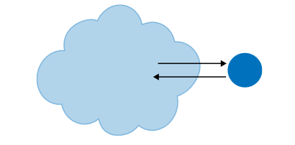
8.Modal panel
This brings a user to a screen with no navigation options other than acknowledging its message, completing its form, or clicking the panel away
A modal window creates a mode that disables user interaction with the main window but keeps it visible, with the modal window as a child window in front of it. Users must interact with the modal window before they can return to the parent window.
User interfaces typically use modal windows to command user awareness and to display emergency states

Slide 21
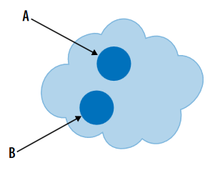
9.Clear entry points
How does a user know where to start in a complex site or app?
The Clear Entry Points pattern shows him where to go first.
For first-time and infrequent users, it removes some of the burden of learning the site.

Slide 22
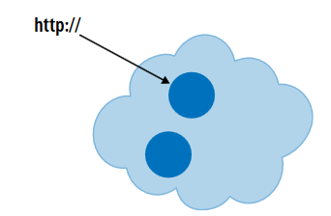
10. Bookmarks
Bookmarks, permalinks, deep links, and Deep-linked State are all ways for a user to conveniently navigate to a point of his choice, anytime he wants, even f it’s deep inside a navigational structure.
These give him a way to avoid traversing many links to get to a desired page or state.
A bookmark is a place holder for a web page that will allow you quick access to that page instead of having to browse to it or search for it.

Slide 23
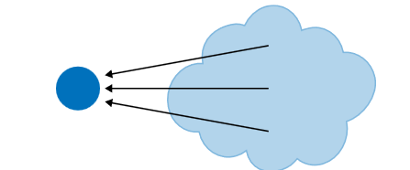
11. Escape hatch
When a user is hopelessly entangled in an app, reaches an error state, or gets deep- linked into a page that he has no context for understanding, he needs an escape hatch a well-labeled link to get back to a known place.

Slide 24
There are three things to notice about these navigational models.
Mix-and-Match: Different navigational mechanisms such as Modal Panels, Clear Entry Points, bookmarks, and Escape Hatches can be combined to suit various contexts without disrupting overall navigation strategies.
Navigation Restriction: The second thing is that some of these mechanisms actually restrict a user’s navigation.
when a user is in the middle of a full-screen slideshow, she doesn’t want to see a complicated global navigation menu! She would rather just focus on the slideshow itself, so Back/Next controls and an Escape Hatch are all that’s necessary.
Implementation Flexibility: Visual representation of navigation elements (tabs, menus, sidebars) and modals (lightboxes or dialogs) can be adapted based on design needs. Prioritize information architecture and navigational models before finalizing visual design.

Slide 25
Design Conventions for Websites
It’s a fine thing to separate the navigational model from its visual design
But websites have certain conventions regarding visual placement of navigational features, and it’s probably unwise to ignore them.
Global navigation is almost always shown at the top or left of a web page, sometimes both. Rarely, it can be found on the right this placement can cause problems with page size and horizontal scrolling
Navigation Patterns:
Fat Menus and Sitemap Footers: Display the entire site structure, using header or footer space.
Utility Navigation: For signed-in users, navigation links like account settings and logout are usually positioned in the upper-right corner.

Slide 26
Design Conventions for Websites
Associative Navigation:
Related Articles: Links to similar content near the main content.
Tags: Enhance navigation by linking articles with common themes, often displayed at the end of articles or as tag clouds.
Tags, both user-defined and system-defined, can help support associative navigation and related articles or links.
Tag clouds support topical findability on some sites, especially where the number of articles is very large and the topics fine-grained.
A more common navigational technique is to list an article’s tags at the end; each tag is a link leading to a whole set of articles that share that tag.
Social Media Integration: Adds additional navigation options such as News Boxes, Content Leaderboards, and Social Sharing Widgets.

Slide 27
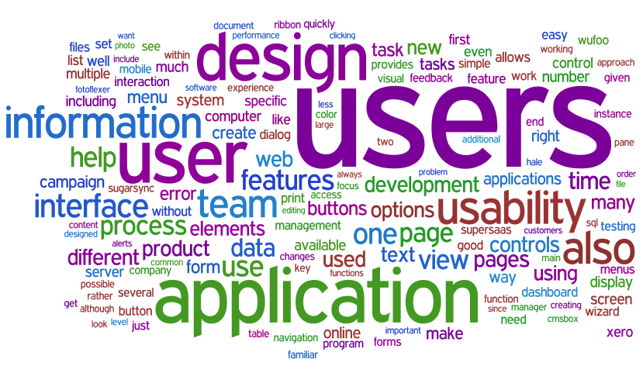

Slide 28
The Patterns- NAVIGATION PATTERNS

Slide 29
Clear Entry Points
Present only a few main entry points into the interface; make them task-oriented and descriptive.
Use when
You’re designing a site or app that has a lot of first-time or infrequent users.
Most of these users would be best served by reading a certain piece of introductory text, doing an initial task, or choosing from a very small number of frequently used options.
If the purpose is clear to nearly everyone who starts using it, and if adding another navigation step might annoy most users (especially those who are intermediate to expert), this design choice might not be the best.

Slide 30
Clear Entry Points- WHY
Some apps and websites can be confusing with too much information and no clear instructions.
To help users, provide a few easy options for getting started.
If these options fit what they expect, they can quickly choose one and start using the app or site, leading to immediate satisfaction.
If not, they will at least understand what the app or site does because you’ve clearly shown the main tasks or categories. This makes the app or site easier to understand.

Slide 31
Clear Entry Points- HOW
When a user first visits the site or opens the app, show them clear "doors" to the main content.
These entry points should guide the user smoothly into the app, giving them enough information to continue on their own.
Make sure these entry points cover the most common reasons users come to the site or app.
There could be just a few or many, depending on your design. Use simple, easy-to-understand language, avoiding technical terms that might confuse new users.
On the home page or starting page, most sites will additionally list other navigation links—global navigation, utility navigation, and so on and these should be smaller and less prominent than the Clear Entry Points.
The Clear Entry Points should serve as the “front doors.”

Slide 32
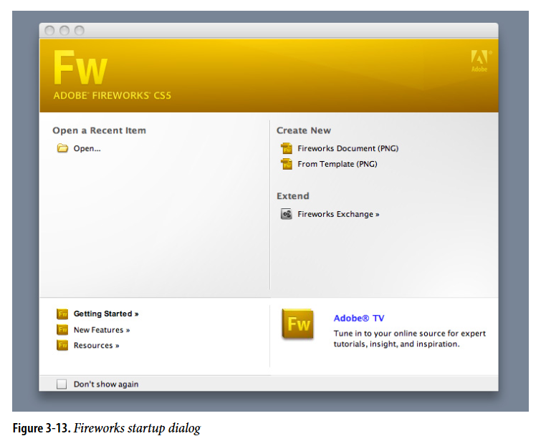
Clear Entry Points- EXAMPLES
Fireworks and other applications show a startup dialog when the application is started .
This orients a new or infrequent user to the possibilities for action; creating something new, opening an existing document, or reading help resources are the most common items to be found here.

Slide 33
Menu Page
Fill the page with a list of links to content-rich pages in your site or app. Show enough information about each link to enable the user to choose well.
Show no other significant content on the page.
Use when
When designing a Menu Page or a table of contents, focus on clarity and simplicity.
This type of page serves as a navigation hub, allowing users to easily find and access different sections of your site or app.
Since it may not include featured content, the design should prioritize a clean layout with clear labels and organized links.
Mobile apps and sites especially need Menu Pages to make the best use of their small screens
While Menu Pages are effective for straightforward navigation, other types of pages might benefit from incorporating promotional or value-explaining content to engage and retain visitors.

Slide 34
Designing a Menu Page requires confidence because you need to be sure that:
Visitors know what the site or app is about.
• They know what they came for and how to find it.
• They wouldn’t be interested in news, updates, or features.

Slide 35
Why
With no distractions, users can focus all their attention on the available navigation options.
You get the entire screen (or most of it, anyway) to organize, explain, and illustrate those links, and can thus direct users to the most appropriate destination page for their needs.

Slide 36
HOW
For mobile design, use Menu Pages to manage complex sites or apps. Keep list labels short, ensure buttons are big enough to tap easily, and avoid deep hierarchies.
For full-size sites and apps:
Label Links Clearly: Use brief and descriptive labels. If extra info or images help users decide, include them carefully to avoid clutter.
Organize Links: Group them logically by category, hierarchy, or date and show this organization clearly.
Include a Search Box: Make it easy for users to find specific content.
Use Space Wisely: On home pages, consider adding interesting content like article teasers or visual elements if it enhances user engagement without overwhelming them

Slide 37
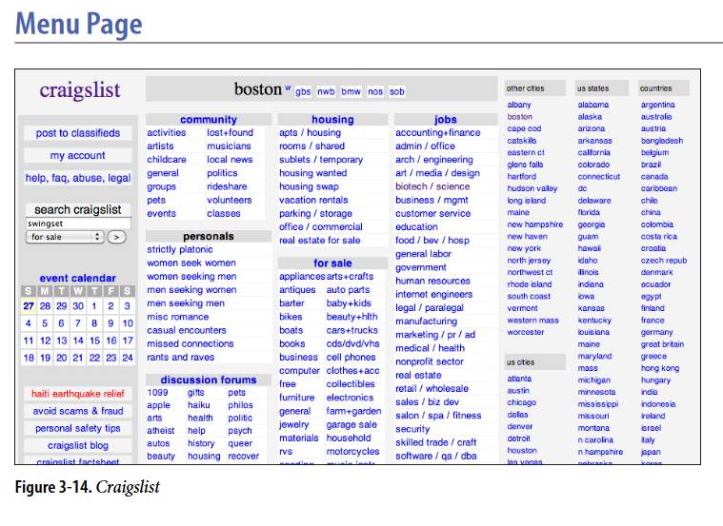
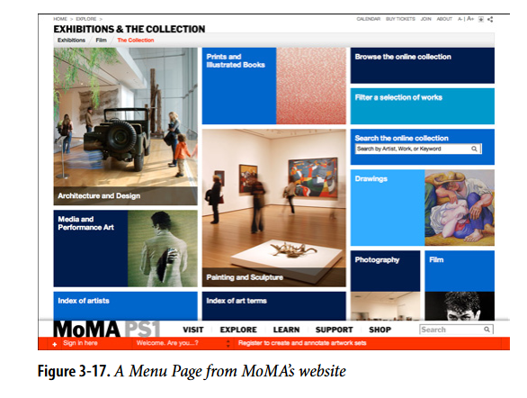
EXAMPLES
The Museum of Modern Art uses large images and little text on this Menu Page

Slide 38
Breadcrumbs
On each page in a deep navigational hierarchy, show a list of all the parent pages, up to the main or home page.
Use when
For applications or websites with deep or complex hierarchies, global navigation may not clearly show a user’s current location. Instead, use clear “You are here” indicators(signposts) to help users understand where they are within the structure.
In cases with large datasets, like online product catalogs, provide effective browsing and filtering tools. This helps users find what they need even if the site’s categorization doesn’t match their search approach.

Slide 39
WHY
Breadcrumbs are navigation aids that display the path from the top of the site or app to the current page.
They help users understand their location within a hierarchy, especially after jumping deep into the structure through search results or filters.
However, unlike Sequence Maps, Breadcrumbs don't indicate the user's next steps; they only show the current position and how the user arrived there.
They are most useful when users have navigated straight down from the top, but less so for complex navigation paths involving multiple branches or direct links.
Finally, Breadcrumbs are usually clickable links or buttons. This turns them into a navigational device in their own right.

Slide 40
HOW
Place a line of text or icons near the top of the page to show the current hierarchical level.
Start with the top level and include each subsequent level leading to the current page, separated by symbols like arrows (→), slashes (/), or greater-than signs (>).
Use page titles for labels, which should be recognizable or self-explanatory.
These labels should be clickable links to their respective pages.
The current page can be the last item in the breadcrumb trail, but it should be visually distinct and not a link, to indicate its current status.

Slide 41
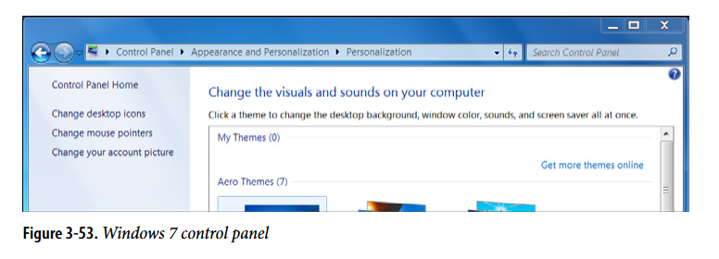
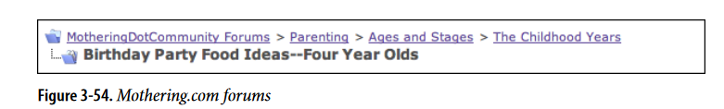
Examples
The Windows 7 control panel is a hierarchical Settings Editor that can be three levels deep.

Slide 42

Bootstrap 5 Navs
If you want to create a simple horizontal menu, add the .nav class to a <ul> element, followed by .nav-item for each <li> and add the .nav-link class to their links:
<ul class="nav"> <li class="nav-item"> <a class="nav-link" href="#">Link</a> </li>
<li class="nav-item"> <a class="nav-link" href="#">Link</a> </li>
……
</ul>

Slide 43
Aligned Nav
Add the .justify-content-center class to center the nav, and the .justify-content-end class to right-align the nav.
<!-- Centered nav --> <ul class="nav justify-content-center"> <!-- Right-aligned nav --> <ul class="nav justify-content-end">
Add the .flex-column class to create a vertical nav:
<ul class="nav flex-column">

Slide 44
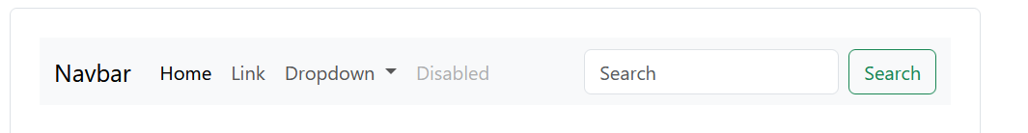
Navbar
A "navbar" is an area on a page that contains navigation components (links, buttons, etc) for getting to other pages of the website.
With Bootstrap, a navigation bar can extend or collapse, depending on the screen size.
A standard navigation bar is created with the .navbar class, followed by a responsive collapsing class: .navbar-expand-xxl|xl|lg|md|sm.
To add links inside the navbar, use either an <ul> element (or a <div>) with class="navbar-nav". Then add <li> elements with a .nav-item class followed by an <a> element with a .nav-link class:
Add the .active class on .nav-link to indicate the current page.

Slide 45
<nav class="navbar navbar-expand-sm "> <div class="container-fluid"> <!-- Links --> <ul class="navbar-nav"> <li class="nav-item"> <a class="nav-link" href="#">Link 1</a> </li>
</ul> </div> </nav>

Slide 46
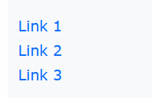
Vertical Navbar & Centered Navbar
Remove the .navbar-expand-* class to create a navigation bar that will always be vertical:
<nav class="navbar "> ... </nav>
Add the .justify-content-center class to center the navigation bar:
<nav class="navbar navbar-expand-sm justify-content-center"> ... </nav>

Slide 47
Colored Navbar
Use any of the .bg-color classes to change the background color of the navbar (.bg-primary, .bg-success, .bg-info, .bg-warning, .bg-danger, .bg-secondary, .bg-dark and .bg-light)
<nav class="navbar navbar-expand-sm bg-light navbar-light">
Add a white text color to all links in the navbar with the .navbar-dark class, or use the .navbar-light class to add a black text color.

Slide 48
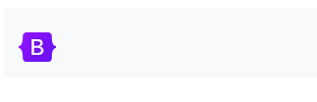
Brand / Logo
The .navbar-brand class is used to highlight the brand/logo/project name of your page:
<a class="navbar-brand" href="#">Logo</a>
When using the .navbar-brand class with images, Bootstrap 5 will automatically style the images
<a class="navbar-brand" href="#"> <img src="logo.png" alt="Avatar Logo" class="rounded"> </a>

Slide 49
<nav class="navbar navbar-light bg-light">
<div class="container-fluid">
<a class="navbar-brand" href="#">Navbar</a>
</div>
</nav>
<!-- As a heading -->
<nav class="navbar navbar-light bg-light">
<div class="container-fluid">
<span class="navbar-brand mb-0 h1">Navbar</span>
</div>
</nav>

Slide 50
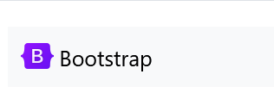
Image and text
Some additional utilities to add an image and text at the same time.
Note the addition of .d-inline-block and .align-text-top on the <img>.
<nav class="navbar navbar-light bg-light">
<div class="container-fluid">
<a class="navbar-brand" href="#">
<img src="/docs/5.0/assets/brand/bootstrap-logo.svg" alt="" width="30" height="24" class="d-inline-block align-text-top">
Bootstrap
</a>
</div>
</nav>

Slide 51
Text
Navbars may contain bits of text with the help of .navbar-text. This class adjusts vertical alignment and horizontal spacing for strings of text.
<nav class="navbar navbar-light bg-light">
<div class="container-fluid">
<span class="navbar-text">
Navbar text with an inline element
</span>
</div>
</nav

Slide 52
Navbar With Dropdown
<li class="nav-item dropdown"> <a class="nav-link dropdown-toggle" href="#" role="button" data-bs-toggle="dropdown">Dropdown</a> <ul class="dropdown-menu"> <li><a class="dropdown-item" href="#">Link</a></li> <li><a class="dropdown-item" href="#">Another link</a></li> <li><a class="dropdown-item" href="#">A third link</a></li> </ul> </li>

Slide 53
Fixed Navigation Bar
The navigation bar can also be fixed at the top or at the bottom of the page.
A fixed navigation bar stays visible in a fixed position (top or bottom) independent of the page scroll.
The .fixed-top class makes the navigation bar fixed at the top:

Slide 54
<nav class="navbar navbar-expand-sm bg-dark navbar-dark fixed-top"> ... </nav>
Use the .fixed-bottom class to make the navbar stay at the bottom of the page:
<nav class="navbar navbar-expand-sm bg-dark navbar-dark fixed-bottom"> ... </nav>

Slide 55
Sticky Navbar
Use the .sticky-top class to make the navbar fixed/stay at the top of the page when you scroll past it. Note: This class does not work in IE11 and earlier
<nav class="navbar navbar-expand-sm bg-dark navbar-dark sticky-top"> ... </nav>

Slide 56
Scrolling
Add .navbar-nav-scroll to a .navbar-nav (or other navbar sub-component) to enable vertical scrolling within the toggleable contents of a collapsed navbar

Slide 57
How it works
Navbars require a wrapping .navbar with .navbar-expand{-sm|-md|-lg|-xl|-xxl} for responsive collapsing and color scheme classes.
Navbars and their contents are fluid by default. Change the container to limit their horizontal width in different ways.
Use our spacing and flex utility classes for controlling spacing and alignment within navbars.
Navbars are responsive by default, but you can easily modify them to change that.
Ensure accessibility by using a <nav> element or, if using a more generic element such as a <div>, add a role="navigation" to every navbar to explicitly identify it as a landmark region for users of assistive technologies.
Indicate the current item by using aria-current="page" for the current page or aria-current="true" for the current item in a set.
You should also add the aria-current attribute on the active .nav-link.

Slide 58

Pagination
If you have a web site with lots of pages, you may wish to add some sort of pagination to each page.
A basic pagination in Bootstrap looks like this:
To create a basic pagination, add the .pagination class to an <ul> element:

Slide 59
<ul class="pagination">
<li class="page-item"><a class="page-link" href="#"> Previous </a> </li>
<li class="page-item"><a class="page-link" href="#">1</a></li>
<li class="page-item"><a class="page-link" href="#">2</a></li>
<li class="page-item"><a class="page-link" href="#">3</a></li>
<li class="page-item"><a class="page-link" href="#">Next</a></li>
</ul>

Slide 60
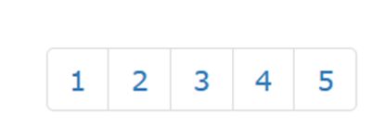
<ul class="pagination"> <li><a href="#">1</a></li> <li><a href="#">2</a></li> <li><a href="#">3</a></li> <li><a href="#">4</a></li> <li><a href="#">5</a></li> </ul>

Slide 61

Active State
The active state shows what is the current page:
Add class .active to let the user know which page he/she is on:
<ul class="pagination"> <li><a href="#">1</a></li> <li class="active"><a href="#">2</a></li> <li><a href="#">3</a></li> <li><a href="#">4</a></li> <li><a href="#">5</a></li> </ul>

Slide 62
Disabled State
A disabled link cannot be clicked:
Add class .disabled if a link for some reason is disabled:
<li class="disabled"><a href="#">4</a></li>

Slide 63

Pagination Sizing
Pagination blocks can also be sized to a larger size or a smaller size:
Add class .pagination-lg for larger blocks or .pagination-sm for smaller blocks:
<ul class="pagination pagination-sm">

Slide 64
Breadcrumbs
Another form for pagination, is breadcrumbs:
The .breadcrumb class indicates the current page's location within a navigational hierarchy:
<ul class="breadcrumb">

Slide 65
Alignment
Change the alignment of pagination components with flexbox utilities.
Add the .justify-content-center class to center the pagination, and the .justify-content-end class to right-align the pagination
<ul class="pagination justify-content-center">

Slide 66
Bootstrap 5 Dropdowns
A dropdown menu is a toggleable menu that allows the user to choose one value from a predefined list:
<div class="dropdown"> <button type="button" class="btn btn-primary dropdown-toggle" data-bs-toggle="dropdown"> Dropdown button </button> <ul class="dropdown-menu"> <li><a class="dropdown-item" href="#">Link 1</a></li> <li><a class="dropdown-item" href="#">Link 2</a></li> <li><a class="dropdown-item" href="#">Link 3</a></li> </ul> </div>

Slide 67
The .dropdown class indicates a dropdown menu.
To open the dropdown menu, use a button or a link with a class of .dropdown-toggle and the data-bs-toggle="dropdown" attribute.
data-bs-toggle: This attribute is used to describe what type of toggling will be done to the button to which it is attached.
Add the .dropdown-menu class to a container element, like <div> or <ul>, to actually build the dropdown menu.
Then add the .dropdown-item class to each element (links or buttons) inside the dropdown menu.

Slide 68
Dropdowns are toggleable, contextual overlays for displaying lists of links and more. They’re made interactive with the included Bootstrap dropdown JavaScript plugin. They’re toggled by clicking, not by hovering; this is an intentional design decision.
Dropdowns are built on a third party library, Popper, which provides dynamic positioning and viewport detection. Be sure to include popper.min.js before Bootstrap’s JavaScript or use bootstrap.bundle.min.js / bootstrap.bundle.js which contains Popper.

Slide 69
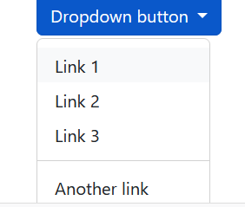
Dropdown Divider
The .dropdown-divider class is used to separate links inside the dropdown menu with a thin horizontal border:
<li><hr class="dropdown-divider"></hr></li>

Slide 70
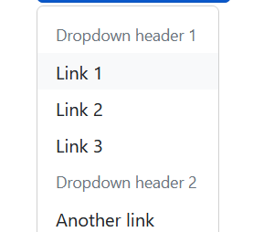
Dropdown Header
The .dropdown-header class is used to add headers inside the dropdown menu:
<li><h5 class="dropdown-header">Dropdown header 1</h5></li>

Slide 71
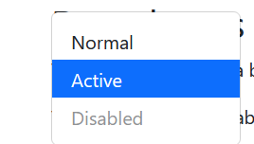
Disable and Active items
Highlight a specific dropdown item with the .active class (adds a blue background color).
To disable an item in the dropdown menu, use the .disabled class (gets a light-grey text color and a "no-parking-sign" icon on hover):

Slide 72
Sizing
Button dropdowns work with buttons of all sizes, including default and split dropdown buttons.
<button class="btn btn-secondary btn-lg dropdown-toggle" type="button" data-bs-toggle="dropdown“>
<button class="btn btn-secondary btn-sm dropdown-toggle" type="button" data-bs-toggle="dropdown“>

Slide 73
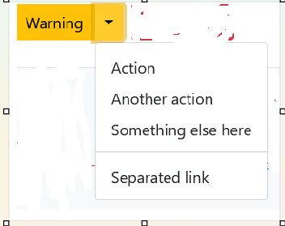
Split button
create split button dropdowns with virtually the same markup as single button dropdowns, but with the addition of .dropdown-toggle-split for proper spacing around the dropdown caret.
<button type="button" class="btn btn-danger dropdown-toggle dropdown-toggle-split“>

Slide 74
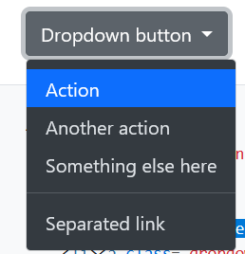
Dark dropdowns
Opt into darker dropdowns to match a dark navbar or custom style by adding .dropdown-menu-dark onto an existing .dropdown-menu. No changes are required to the dropdown items.
<ul class="dropdown-menu dropdown-menu-dark“>

Slide 75



Directions
Dropup---Trigger dropdown menus above elements by adding .dropup to the parent element.
<div class=“btn-group dropup">
Dropright---Trigger dropdown menus at the right of the elements by adding .dropend to the parent element.
<div class="btn-group dropend">
Dropleft---Trigger dropdown menus at the left of the elements by adding .dropstart to the parent element.
<div class="btn-group dropstart">

Slide 76
Menu alignment
By default, a dropdown menu is automatically positioned 100% from the top and along the left side of its parent. You can change this with the directional .drop* classes, but you can also control them with additional modifier classes.

Slide 77
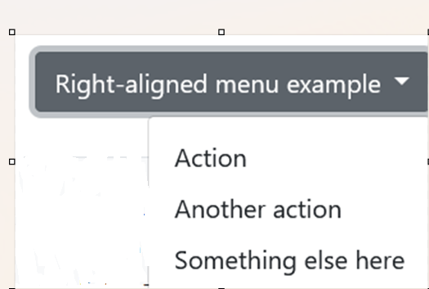
Add .dropdown-menu-end to a .dropdown-menu to right align the dropdown menu.
<ul class="dropdown-menu dropdown-menu-end">

Slide 78
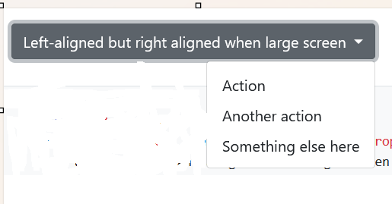
Responsive alignment
If you want to use responsive alignment, disable dynamic positioning by adding the data-bs-display="static" attribute and use the responsive variation classes.
LEFT ALIGNED BUT RIGHT ALIGNED ON LARGE SCREEN
To align right the dropdown menu with the given breakpoint or larger, add .dropdown-menu{-sm|-md|-lg|-xl|-xxl}-end.
<button type="button" class="btn btn-secondary dropdown-toggle" data-bs-toggle="dropdown" data-bs-display="static“>
<ul class="dropdown-menu dropdown-menu-lg-end">

Slide 79
RIGHT ALIGNED BUT LEFT ALIGNED ON LARGE SCREEN
To align left the dropdown menu with the given breakpoint or larger, add .dropdown-menu-end and .dropdown-menu{-sm|-md|-lg|-xl|-xxl}-start.
<ul class="dropdown-menu dropdown-menu-end dropdown-menu-lg-start">

